Slide 1
Welcome Junior‘s
Bismilllahhir Rahmanir Rahim
Hosted and prepared by
MD. SOROWAR MAHABUB RABBY
Department of CSE (Computer Science and Engineering) , IIUC
Cell: 01834756433, 01521564157
E-mail: sorowarmahabub1709vip@gmail.com

Slide 2
Basic C Programming Structure
#include<stdio.h>
int main()
{
//
return 0;
}

Slide 3


Slide 4
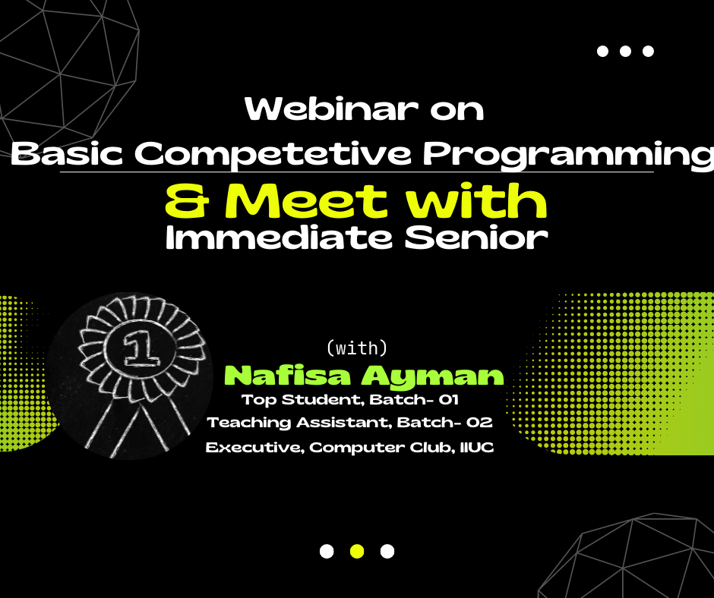

Slide 5
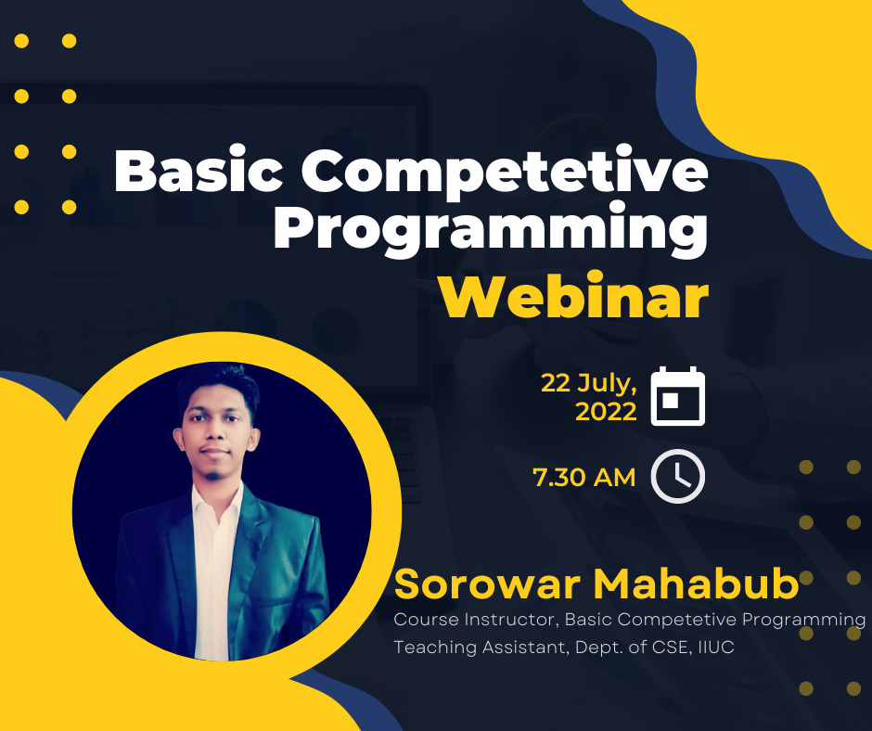

Slide 6
Hello World in 1 C Programming
#include<stdio.h>
int main()
{
printf("Hello world!");
return 0;
}

Slide 7
Hello World in 2 Vjudge Contest- 001
#include<stdio.h>
int main()
{
printf("Hello, World!");
return 0;
}

Slide 8
01961537181
Pera nai, Chill

Slide 9

Thanks
(Jajakallah Khairan)

